Slide 1
Determinant
Dhifaf Abdul-Kareem Abood

Slide 2
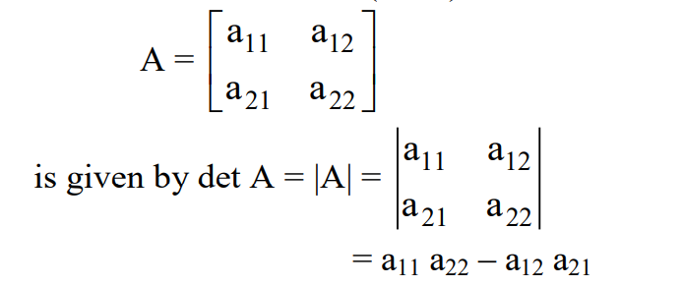
Determinant:
The Determinant of a Matrix: The determinant of a matrix is a scalar (number), obtained from the elements of a matrix by specified operations, which is characteristic of the matrix. The determinants are defined only for square matrices. It is denoted by det A or |A| for a square matrix A. The determinant of the (2 x 2) matrix

Slide 3
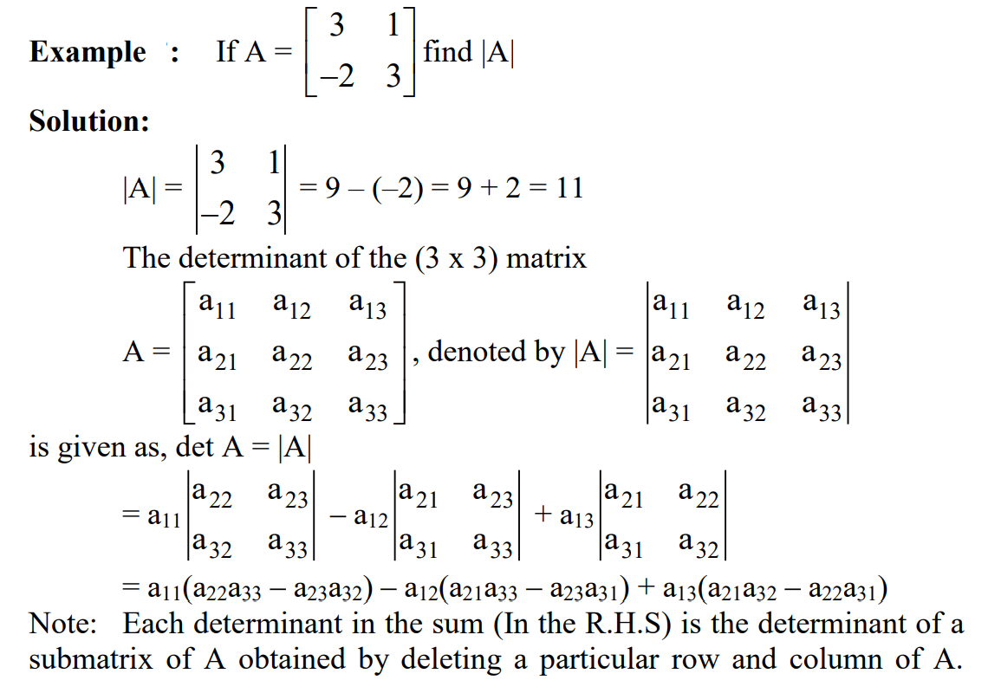

Slide 4
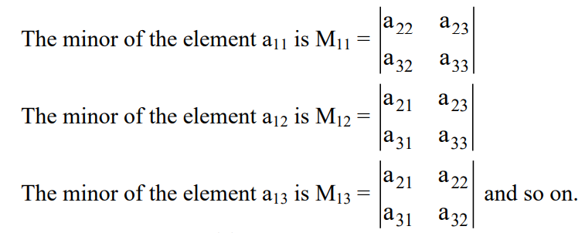
Minor and Cofactor of Element:
The minor Mij of the element aij in a given determinant is the determinant of order (n – 1 x n – 1) obtained by deleting the ith row and jth column of Anxn.
For example in the determinant

Slide 5
The scalars are called the cofactor of the element aij of the matrix A.
Note: The value of the determinant in equation (1) can also be found by its minor elements or cofactors, as
Hence the det A is the sum of the elements of any row or column multiplied by their corresponding cofactors. The value of the determinant can be found by expanding it from any row or column.

Slide 6
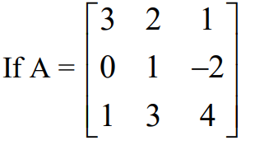
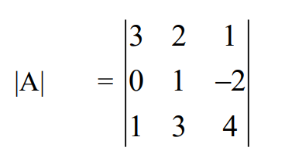
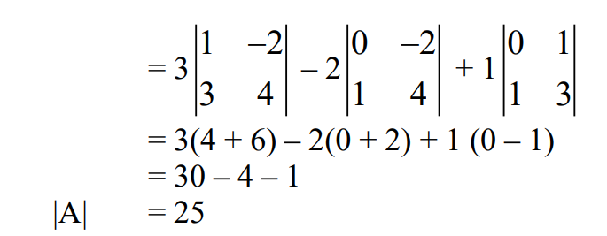
Example:
find det A by expansion about (a) the first row (b) the first column.
Solution (a)

Slide 8
Properties of the Determinant:
The following properties of determinants are frequently useful in their evaluation: 1. Interchanging the corresponding rows and columns of a determinant does not change its value (i.e., |A| = |A’|). For example, consider a determinant
= a1(b2c3 – b3c2) – b1(a2c3 – a3c2)+ c1(a2b3 – a3b2) ... (2)

Slide 9
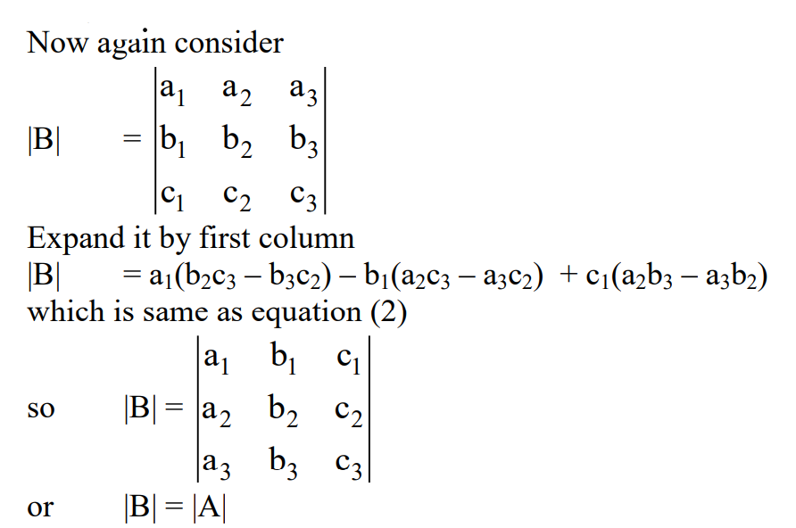

Slide 10
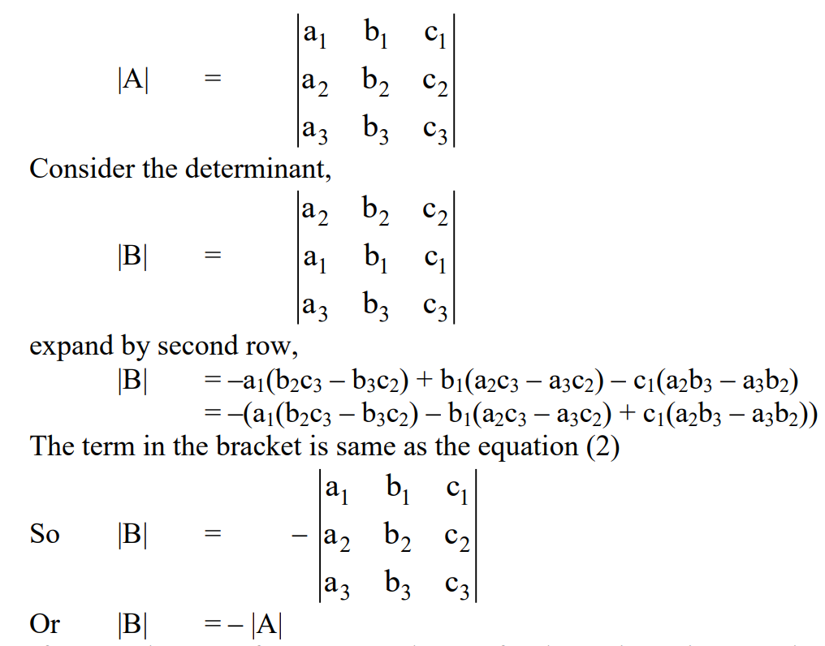
2. If two rows or two columns of a determinant are interchanged, the sign of the determinant is changed but its absolute value is unchanged. For example if

Slide 11
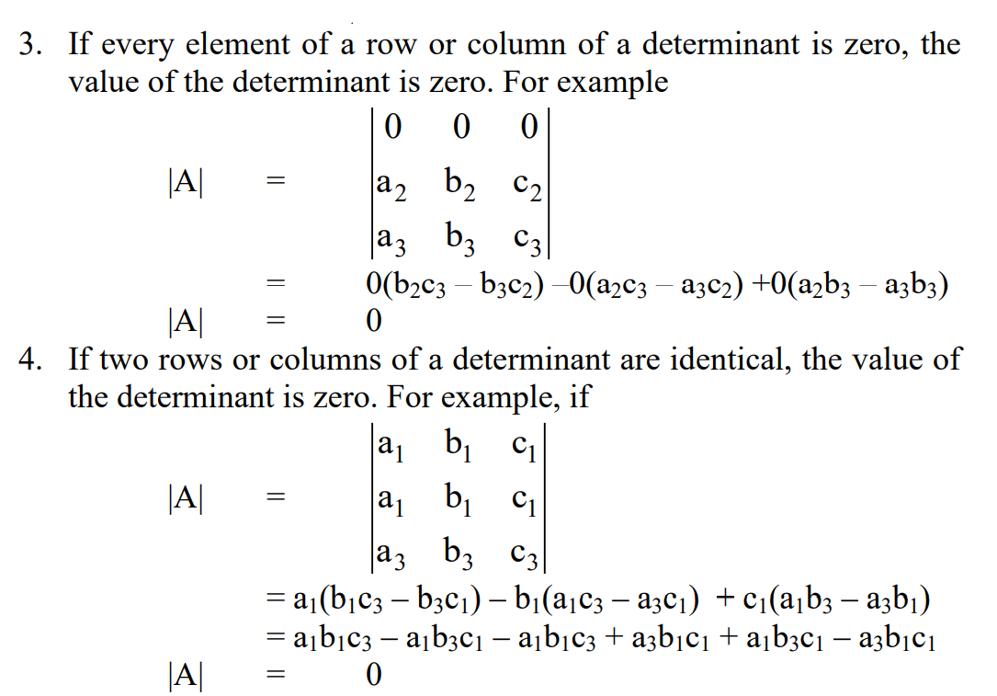

Slide 12
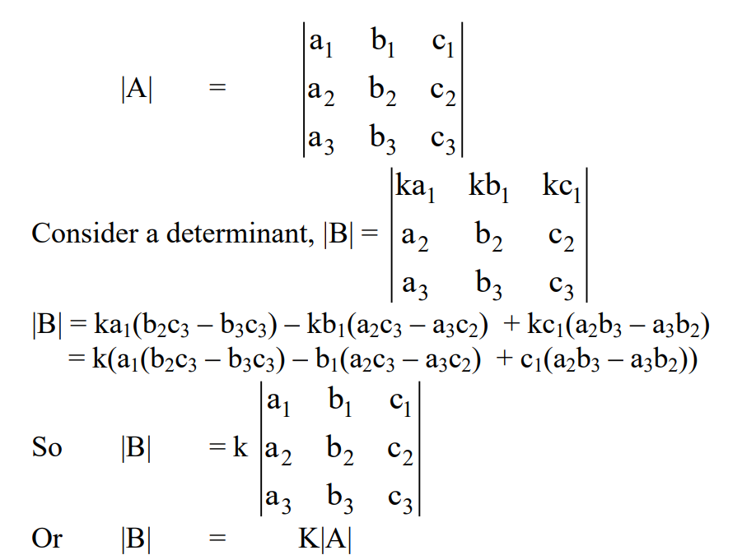
5. If every element of a row or column of a determinant is multiplied by the same constant K, the value of the determinant is multiplied by that constant. For example if,

Slide 13
Thank You

